Slide 1
Learning RoI Transformer for Oriented Object Detection in Aerial Images
Citations: 1494
Jian Ding, Nan Xue, Yang Long, Gui-Song Xia∗, Qikai Lu
LIESMARS-CAPTAIN, Wuhan University, Wuhan, 430079, China
IEEE/CVF Conference on Computer Vision and Pattern Recognition (CVPR), 2019
DOI: 10.1109/CVPR.2019.00296.

Slide 2
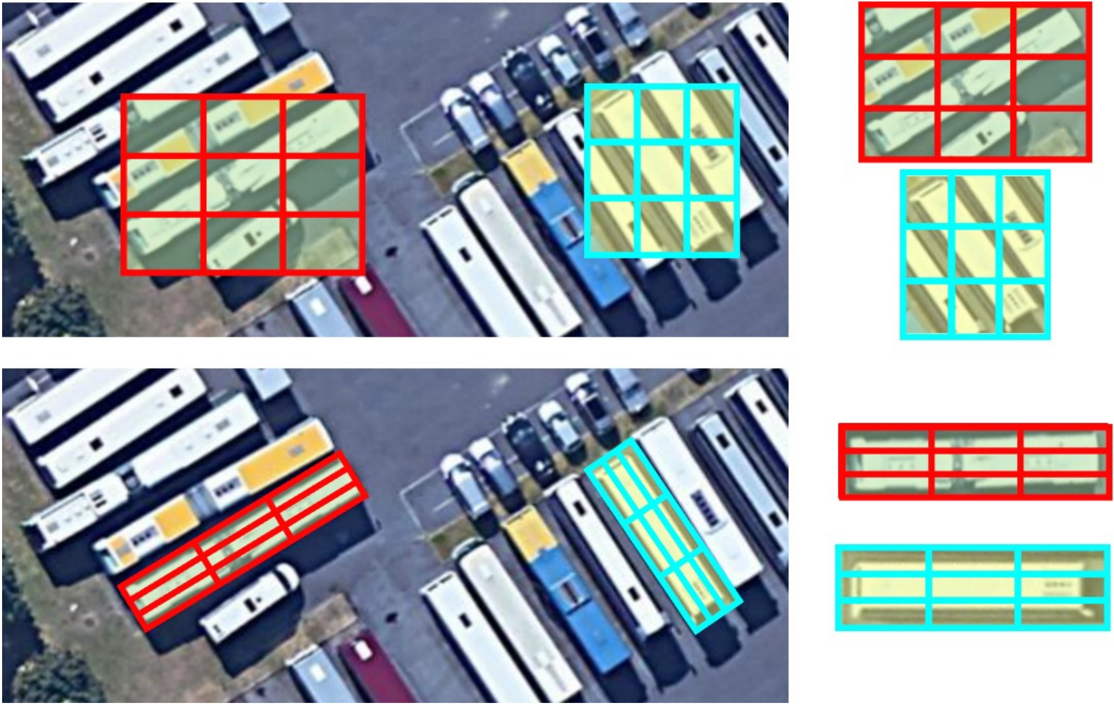
Introduction: Horizontal RoIs
Challenges: Complex backgrounds, and arbitrary oriented objects.
Limitations: Causing severe feature misalignment for densely packed objects.
Consequence: A single HRoI often contains multiple objects, confusing classification and localization.
Figure 1. An aerial image applied Horizontal ROI

Slide 3
Introduction: HROI v.s. RROI
Figure 2. Horizontal (top) v.s. Rotated RoI warping (bottom)
Notes:
ROI Warping provides more accurate regions which match objects

Slide 4
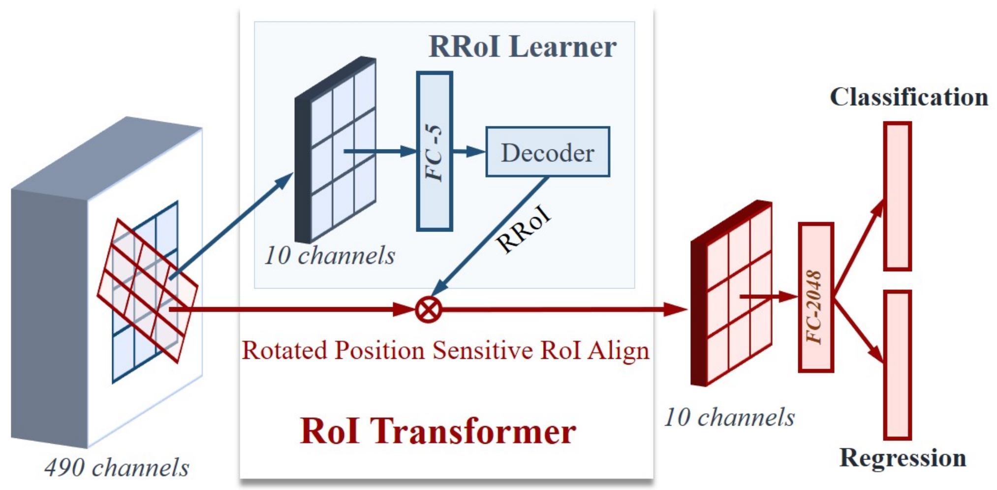
Method: RoI Transformer
Figure 3. The architecture of RoI Transformer.
Notes:
ROI Warping provides more accurate regions which match objects

Slide 5
Method: Pipeline
Steps:
Input: Image patch of 1024 × 1024 × 3.
Backbone: ResNet-101 (optionally with FPN) produces the shared feature map.
Light head: Large separable conv (k = 15, C_mid = 256) gives the thin feature
D: H × W × 490.
RPN: 15 horizontal anchors, 6000 proposals → NMS → 800 HRoIs (x, y, w, h).
RRoI Learner: PS RoI Align → FC(5) → box decoder → RRoI.
RRoI Warping: RPS RoI Align outputs Y: 7 × 7 × 10.
Head: One 2048-d FC, then sibling FCs for classification and OBB regression.
Figure 3. The architecture of RoI Transformer.
Notes:
ROI Warping provides more accurate regions which match objects

Slide 6
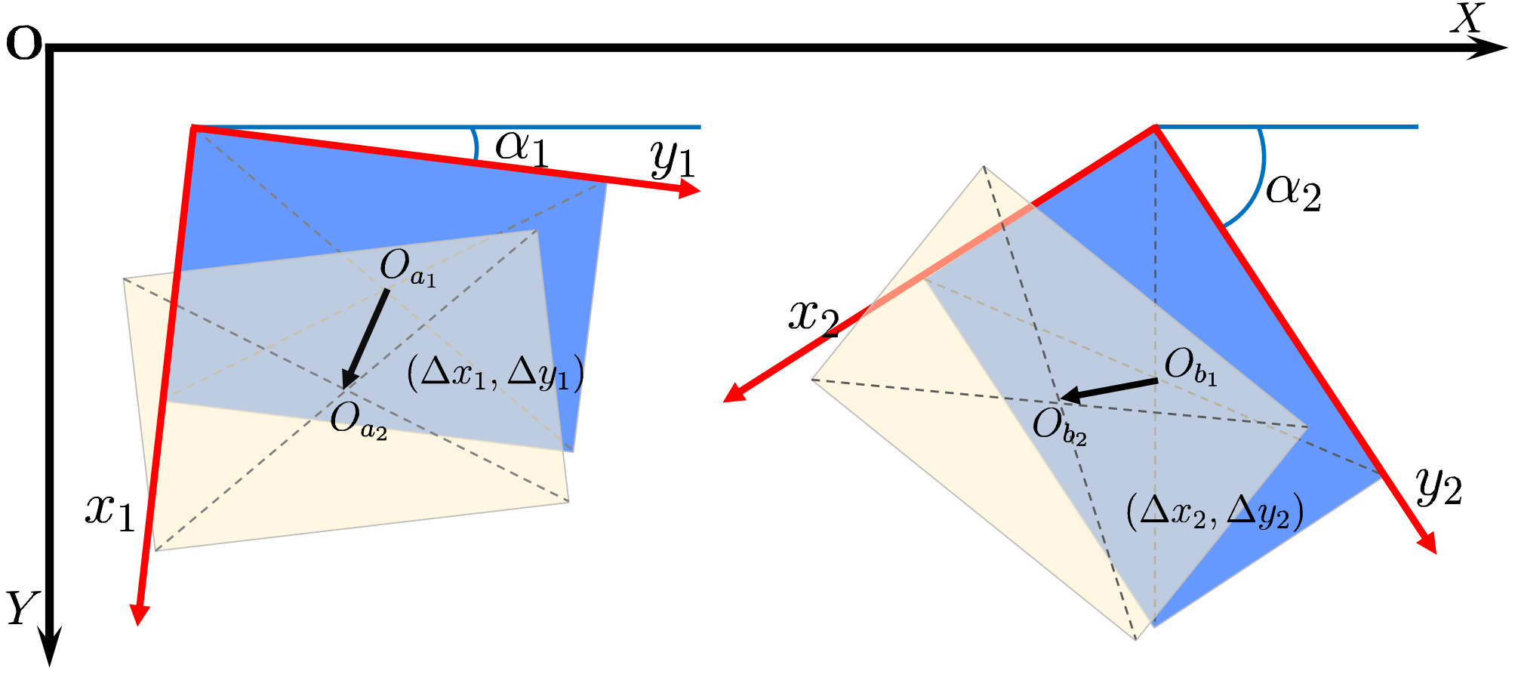
Method: Relative Offset
Problem: A global-coordinate offset gives a different number for the same relative position at every rotation angle.
Solution: Express the offset in the RRoI's own local frame
Figure 4. An example explaining the relative offset.

Slide 7
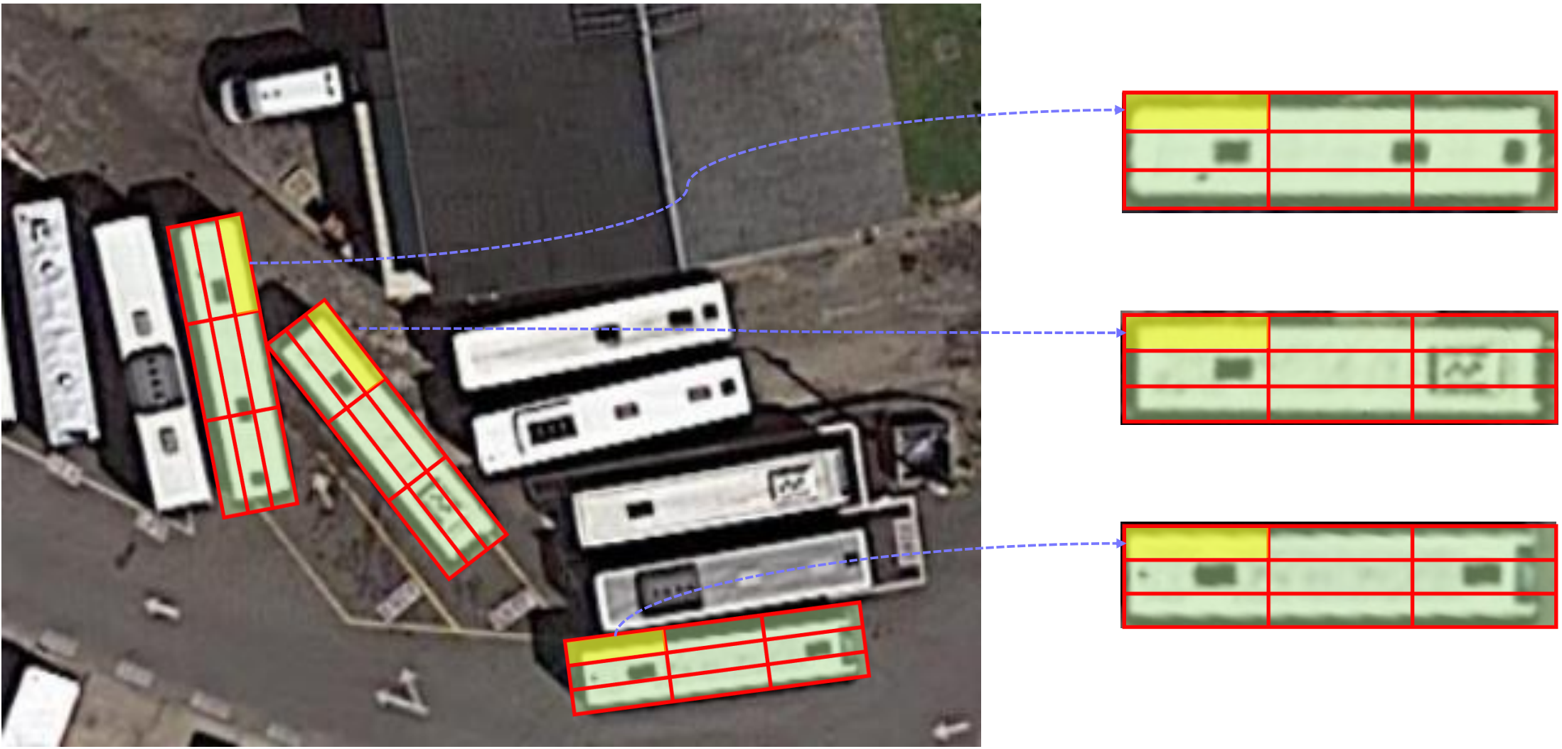
Method: RRoI warping
Process: Split the RRoI into K × K bins in its own local frame, then rotate each sampling point back onto the feature map.
Interpolation: Sample locations land on non-integer coordinates, so values come from bilinear interpolation — the whole step stays differentiable.
Position sensitive: Output cell (𝑖,𝑗) reads only the matching channel (𝑖,𝑗) out of the K × K × C feature, inherited from R-FCN.
Figure 5. Rotated RoI warping
Notes:
ROI Warping provides more accurate regions which match objects

Slide 8
Datasets:
DOTA:
The largest aerial image dataset, containing 2,806 large images, 188,282 instances, 15 categories.
HSRC 2016:
Focused on ship detection, 1061 images and more than 20 categories of ships.

Slide 9
Datasets: Preprocessing
DOTA:
Resized the images at scales 1.0 & 0.4 for training and scales 1.0 & 0.5 for testing.
Crop a series of 1024 × 1024 patches from the original images
Rotation augmentation randomly from 4 angles (0, 90, 180, 270)
HSRC 2016:
Applied horizontal flipping
resized to (S, M) = (512, 800)
S = short side
M = maximum length

Slide 10
Results: HSRC2016
Table 1. Comparisons with the state-of-the-art methods on HRSC2016.

Slide 11
Results: DOTA
Baseline (Light-Head R-CNN OBB): A fast two-stage detector modified to predict oriented boxes.
Competitor (DPSRP): Deformable PS RoI Pooling learns flexible spatial offsets to adapt geometric deformations.

Slide 12
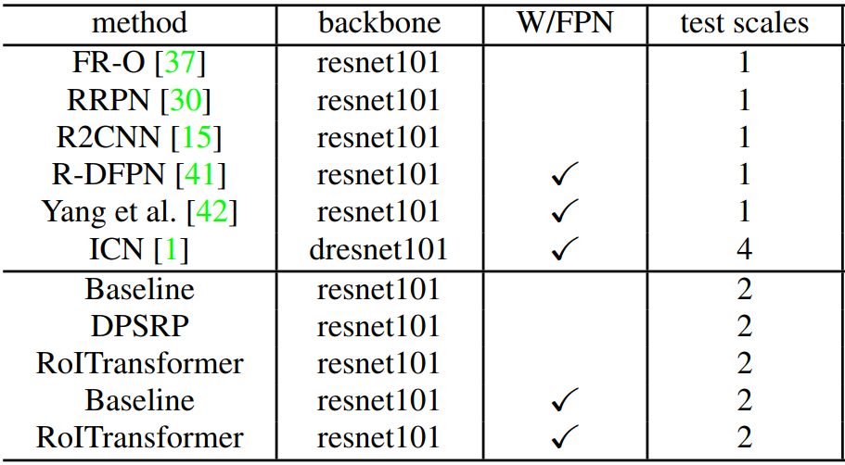


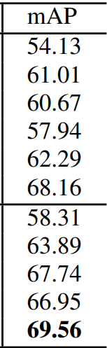
Results: DOTA
Table 2. Comparisons with state-of-the-art detectors on DOTA

Slide 13
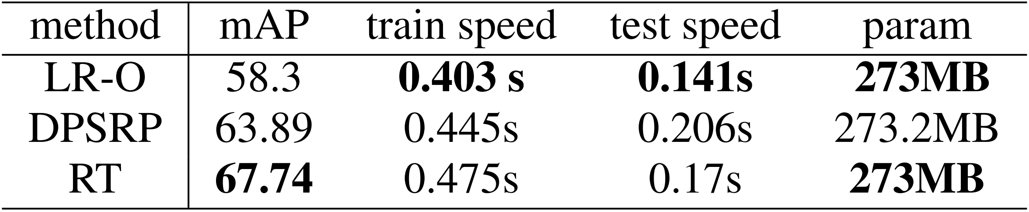
Results: DOTA
Table 3. Comparison of our RoI Transformer with deformable PS RoI pooling and Light-Head R-CNN OBB on accuracy, speed and memory.

Slide 14
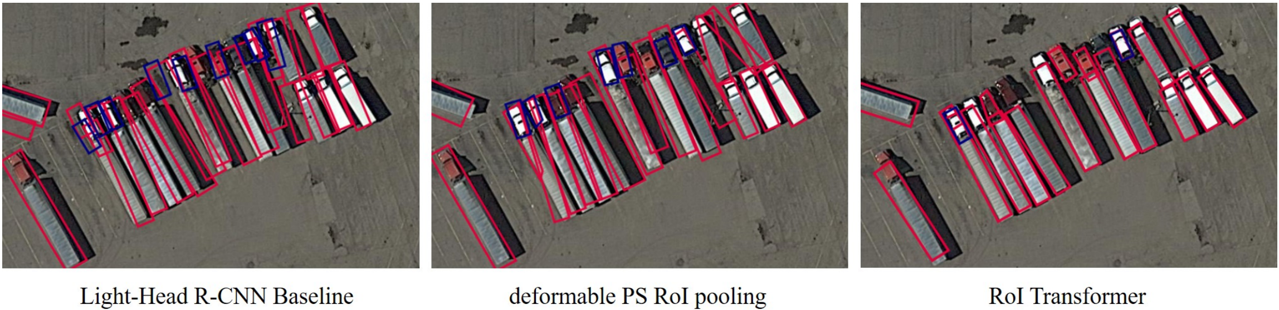
Results: DOTA
Figure 4. Visualization of detection on the scene where many densely packed instances exist.

Slide 15
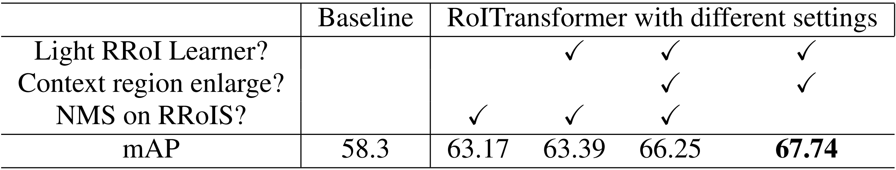
Ablation Study on DOTA
Findings:
Plugging in the module alone gains 4.87 mAP.
A precise RRoI keeps almost no background, so mild enlargement adds 2.86 mAP.
Skipping NMS on RRoIs keeps more proposals and raises recall, adding 1.5 mAP.
Table 4. Results of ablation studies. (Without FPN)

Slide 16
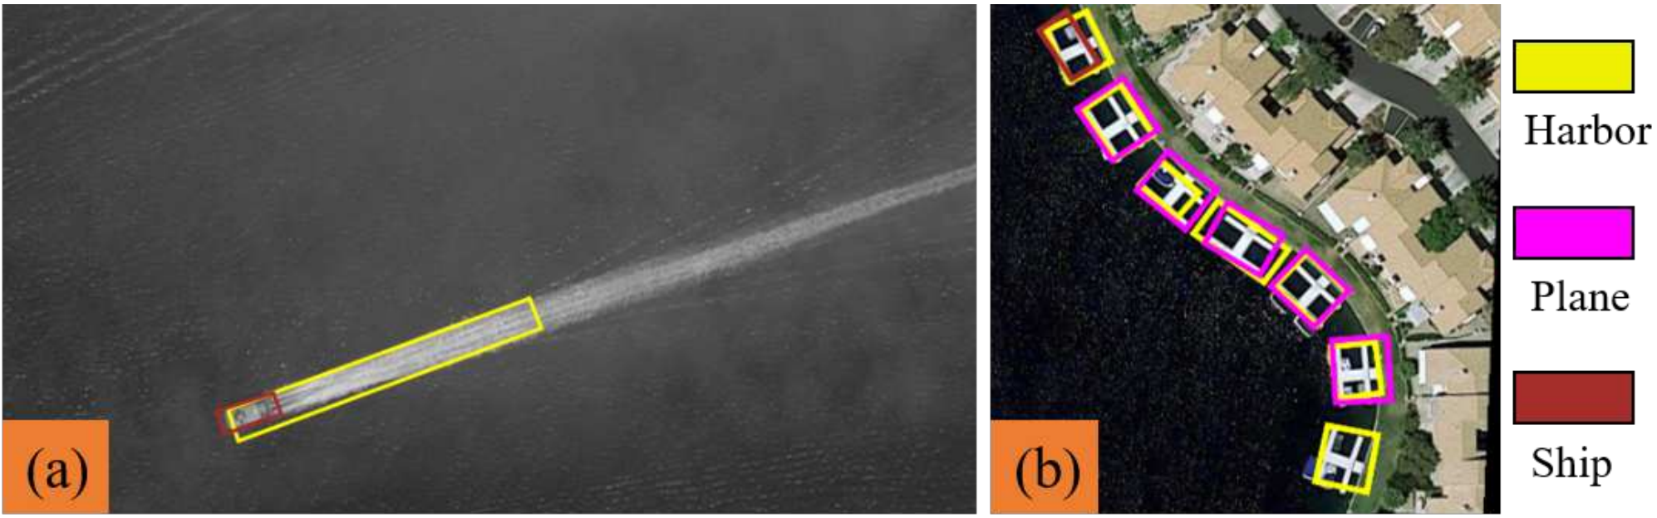
Conclusions
Application Limit: Fails in ambiguous scenes without global context
Future Work: Integrate broader contextual learning networks to distinguish objects from confusing backgrounds.
Figure 6. Failure cases.

